Slide 1
External Sourcing Agent
Finding people is easy. Defending why they qualify is the engineering problem.
Data Engineer take-home · Tungsten Automation and Polish Rail Freight briefs

Slide 2
Search finds hundreds of plausible profiles; proving which ones qualify is the work
TODAY
TUNGSTEN RUN: FROM SEARCH HIT TO SHORTLIST
About half the experts on client calls are not in our database
Researchers find them by hand on LinkedIn, late in the project, one search at a time
294
candidates found by search
116
passed verification in code
EVERY EXPERT RETURNED NEEDS
A relevant role and company
A public profile we can open
Evidence for why they fit the brief
No excluded or ineligible employer
60
returned, 20 per group
6 in 10 candidates that search finds fail the rules. Returning them would put ineligible people in front of a client.
THE PROBLEM

Slide 3
Approach: hard rules run in code; the LLM judges only what code cannot
CODE DECIDES: TESTABLE, SAME EVERY RUN
THE LLM JUDGES (CLAUDE)
Employment dates and departure windows
Exclusions, including the former name Kofax
Organisation matching ("Kofax India Pvt Ltd" counts as Kofax)
Merging the same person across sources
Work history parsed from structured profile data
Reads the brief into rules, each quoting the brief
Writes role words and discovery queries
Reads relevant pages for named people and customers
Checks requirements code cannot ("a product leader")
Scores fit and writes the reason, citing evidence
A hard rule rejects, and no score can rescue it: still at Tungsten or Kofax, left under 6 months ago, founder or C-level at a competitor. A preference only changes the score: ideal titles, "ideally 8+ years".
APPROACH

Slide 4
Discovery: the brief decides between two search strategies
1 People first
2 Companies, then people
WHEN
WHEN
The brief names the organisations
No organisations named in the brief
HOW
HOW
Google LinkedIn X-rays at each named organisation, sliced by departure quarter and job function, since each search returns about 10 profiles. Exa tops up short groups.
Find organisations first in case studies, press releases and registers, each with a quote that code checks. Then one X-ray per organisation, in batches of 10, until the group has enough.
USED FOR
USED FOR
Tungsten: former employees, competitors
Tungsten: customers
Polish rail: all three groups
Both stop once a group has X qualified candidates: ample groups stay cheap, thin groups keep searching. The parsed brief picks the strategy, so no brief needs its own code.
APPROACH · DISCOVERY

Slide 5
Nine stages: code enforces the rules, the LLM reads language, and every stage can be inspected
UNDERSTAND THE BRIEF
FIND PEOPLE
DECIDE
1
Brief parsing
Groups, aliases, date windows, each quoted
3
Search
Google (Serper) and Exa in parallel
7
Entity resolution
A name alone never merges two people
2
Query generation
Code templates plus LLM role words
4
Extract candidates
Code parses profiles; LLM reads pages
8
Verification
Code only: dates, exclusions, roles
5
People per company
One X-ray per customer or operator
9
Ranking
LLM judges fit; code weights, top 20
6
Profile lookup
Name and employer must both match
Every stage's file is a resume point: fix the rules, queries or customer list without paying again.
LLM involved
Code only
HOW IT WORKS

Slide 6
Each way the pipeline could lie to us has a guard
Risk | Guard | How it was checked
Made-up people | Real search hits; names and quotes verified against source text | Code-level quote verification; reviewer opened every sample link
Stale roles | Dated work history; conflicting current-role signals checked | Tests cover stale headlines and employment-window boundaries
Name collisions | Merge by profile URL or name + shared employer, never name alone | 16 Tungsten records merged; no duplicates left
Renamed companies | Brief's aliases matched as whole words ("Kofax India Pvt Ltd") | 0 exclusion violations in the sample
Never used the product | Product-specific evidence required; Haiku assesses hands-on use | 27 Tungsten customer-company candidates rejected
Thin groups padded | Only qualified candidates returned; unclear cases flagged for review | Polish planners: 0 returned, 8 for review
HOW IT WORKS · VERIFICATION

Slide 7
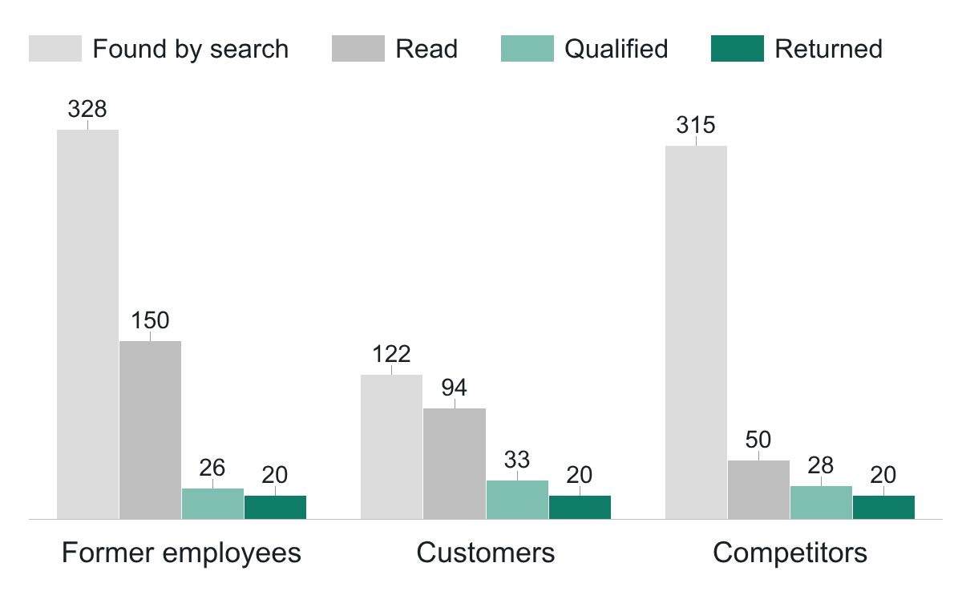
Tungsten: 60 experts returned, and all 60 passed hand review
60 of 60
Candidates per group at each step, Tungsten run of 11 Oct 2026
experts valid on hand review
One reviewer opened every profile and evidence link
0 exclusion violations, 0 duplicates
no recall claimed
Search stopped at 25 qualified; unread profiles ranked lower, not rejected
244 offline tests; 16 borderline kept for review
Customers found: 77 profiles plus 45 people named on case studies. Qualified = passed the code checks and the LLM judged they meet the brief.
RESULTS · TUNGSTEN

Slide 8
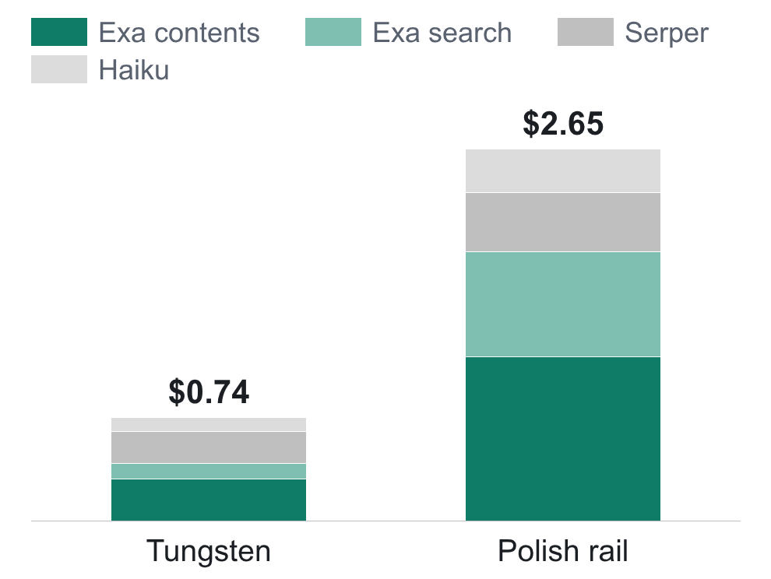
Every run records its cost and time: Tungsten $0.74 in 5½ minutes, Polish $2.65 in 17
API cost per full run, 11 Oct 2026 ($)
$0.74
Tungsten · 5m 30s
$2.65
Polish · 16m 35s
Polish costs more: it finds organisations first, and the planner group never stops early
Adaptive stopping and conditional paging skip results we don't need
Measured runs at list prices; totals vary about ±20%
RESULTS · COST AND TIME

Slide 9
The Polish brief ran on the same pipeline and exposed one real gap, which the system did not hide
SAME PIPELINE, BRIEF-DRIVEN RULES
 | Tungsten Automation | Polish Rail Freight
Search language | English | Polish and English
Organisations named | Target, alias, competitors | None: discovered first
Exclusions | Current and former staff | Current staff only
Groups filled | 3 of 3 (60 experts) | 2 of 3 (40 experts)
THE GAP: 0 CONFIDENT INFRASTRUCTURE PLANNERS
Search found ex-PKP PLK and UTK department heads, but no public profile states a train-path or access-charge remit. 8 went to review rather than onto the list.
Zero confident results is a coverage problem to solve, not a reason to relax the rule.
RESULTS · SECOND BRIEF

Slide 10
Six things that went wrong during the build; each was caught by a live run or a check
Brave mangled search operators
Exa ignores "former"
Ideal titles treated as rules
Live probes showed X-ray filters ignored. Switched to Google via Serper
About half its "former" results still worked there. Status now comes from work history
10 good former employees rejected. Now only hard requirements reject: 1 after
Early stop counted the wrong thing
A loose profile match
Runs degraded silently
Date fit stopped "lead" groups early (11 of 41 were leads). Now it counts LLM-qualified
"Rail Polska" matched "DB Schenker Rail Polska". Now exact employer, single match
Credits ran out twice; rate limits lost 16 pages. Now quota errors stop the run
WHAT WENT WRONG

Slide 11
What I learned and what comes next
LESSONS
NEXT
AT VOLUME
Keep hard rules deterministic
Search until enough people qualify, not until results run out
Send thin evidence to a human; never pad
Label the Polish results
Add a second reviewer to measure agreement
Improve discovery for sparse groups
Try Jev for sub-second verdicts
Cache pages and searches with an expiry
Learn from reviewer rejections
Monitor quality and cost per brief
The deliverable is not just a list of people. It is a sourcing process whose results, decisions, costs and limits can all be inspected.
WHAT COMES NEXT

Slide 12
Thank you
Questions on the design and results

